Slide 1
Exception Handling

Slide 2
An exception is an abnormal condition that arises in a code sequence at run time.
An exception is a run-time error.
In computer languages that do not support exception handling, errors must be checked and handled manually.
Java’s exception handling avoids these problems.

Slide 3
A Java exception is an object that describes an exceptional (that is, error) condition that has occurred in a piece of code.
When an exceptional condition arises, an object representing that exception is created and thrown in the method that caused the error.
Exceptions can be generated by the Java run-time system, or they can be manually generated by our code.

Slide 4
class Exc0
{
public static void main(String args[])
{
int d = 0;
int a = 42 / d;
System.out.println(“This code is safe”);
}
}

Slide 5
When the Java run-time system detects the attempt to divide by zero, it constructs a new exception object and then throws this exception.
This causes the execution of Exc0 to stop, because once an exception has been thrown, it must be caught by an exception handler and dealt with immediately.
Any exception that is not caught by our program will ultimately be processed by the default handler.
The default handler displays a string describing the exception, prints a stack trace from the point at which the exception occurred, and terminates the program.

Slide 6
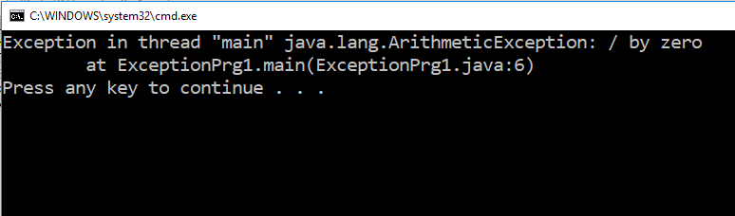
Here is the output generated when this example is executed.
java.lang.ArithmeticException: / by zero
at Exc0.main(Exc0.java:4)

Slide 7
class Exc1
{
static void subroutine()
{
int d = 0;
int a = 10 / d;
}
public static void main(String args[])
{
Exc1.subroutine();
}
}

Slide 8
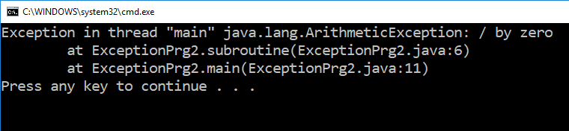
The resulting stack trace from the default exception handler shows how the entire
call stack is displayed:
java.lang.ArithmeticException: / by zero
at Exc1.subroutine(Exc1.java:4)
at Exc1.main(Exc1.java:7)

Slide 9
Using try and catch
try
{
}
catch (Exception e)
{
}
Exception
ArithmeticException
ArrayIndexOutOfBoundsException

Slide 10
Using try and catch
class Exc2
{ public static void main(String args[])
{ int d, a;
try
{ d = 0; // take input to d variable from the user
a = 42 / d;
System.out.println("This will not be printed.");
}
catch (ArithmeticException e)
{
System.out.println("Division by zero.");
}
System.out.println("After catch statement.");
}
}

Slide 11
This program generates the following output:
Division by zero.
After catch statement.

Slide 12
class HandleError
{ public static void main(String args[])
{ int a=0, b=0, c=0;
Random r = new Random();
for(int i=0; i<1000; i++)
{ try
{ b = r.nextInt();
c = r.nextInt();
a = 12345 / (b/c);
}
catch (ArithmeticException e)
{ System.out.println("Division by zero.");
a = 0; // set a to zero and continue
}
System.out.println("a: " + a);
} } }

Slide 13
Displaying a Description of an Exception
catch (ArithmeticException e)
{
System.out.println("Exception: " + e);
a = 0; // set a to zero and continue
}
When the program is run, each divide-by-zero error displays the following message:
Exception: java.lang.ArithmeticException: / by zero

Slide 14
Multiple catch Clauses
class MultiCatch
{ public static void main(String args[])
{ try
{ int a = args.length;
System.out.println("a = " + a);
int b = 42 / a;
int c[] = { 1 };
c[5] = 99;
}
catch(ArithmeticException e)
{ System.out.println("Divide by 0: " + e);
}
catch(ArrayIndexOutOfBoundsException e)
{ System.out.println("Array index oob: " + e);
}
System.out.println("After try/catch blocks.");
} }

Slide 15
C:\>java MultiCatch
a = 0
Divide by 0: java.lang.ArithmeticException: / by zero
After try/catch blocks.

Slide 16
C:\>java MultiCatch TestArg
a = 1
Array index oob: java.lang.ArrayIndexOutOfBoundsException
After try/catch blocks.

Slide 17
When we use multiple catch statements, it is important to remember that exception subclasses must come before any of their superclasses.
This is because a catch statement that uses a superclass will catch exceptions of that type plus any of its subclasses.
Thus, a subclass would never be reached if it came after its superclass.
Further, in Java, unreachable code is an error.

Slide 18
class SuperSubCatch
{ public static void main(String args[])
{ try
{ int a = 0;
int b = 42 / a;
}
catch(Exception e)
{ System.out.println("Generic Exception catch.");
}
catch(ArithmeticException e)
{ // ERROR – unreachable // Compilation error
System.out.println("This is never reached.");
}
} }

Slide 19
If we try to compile the program, we receive an error message stating that second catch statement is unreachable because the exception has already been caught.
Since ArithmeticException is a subclass of Exception, the first catch statement will handle all Exception-based errors, including ArithmeticException.
This means that the second catch statement will never execute.
To fix the problem, reverse the order of the catch statements.

Slide 20
Nested try Statements
class NestTry
{ public static void main(String args[])
{ try
{ int a = args.length;
int b = 42 / a;
System.out.println("a = " + a);
try
{ if(a==1)
a = a/(a-a); // division by zero
if(a==2)
{ int c[] = { 1 };
c[5] = 99; // generate an out-of-bounds exception
}
}
catch(ArrayIndexOutOfBoundsException e)
{ System.out.println("Array index out-of-bounds: " + e);
}
}
catch(ArithmeticException e)
{ System.out.println("Divide by 0: " + e);
}
}
}

Slide 21
C:\>java NestTry
Divide by 0: java.lang.ArithmeticException: / by zero
C:\>java NestTry One
a = 1
Divide by 0: java.lang.ArithmeticException: / by zero
C:\>java NestTry One Two
a = 2
Array index out-of-bounds: java.lang.ArrayIndexOutOfBoundsException

Slide 22
/* Try statements can be implicitly nested via calls to methods. */
class MethNestTry
{ static void nesttry(int a)
{ try
{ if(a==1)
a = a/(a-a); // division by zero
if(a==2)
{ int c[] = { 1 };
c[42] = 99; // generate an out-of-bounds exception
}
}
catch(ArrayIndexOutOfBoundsException e)
{ System.out.println("Array index out-of-bounds: " + e); }
}
public static void main(String args[])
{ try { int a = args.length;
int b = 42 / a;
System.out.println("a = " + a);
nesttry(a);
}
catch(ArithmeticException e)
{ System.out.println("Divide by 0: " + e);
}
} }

Slide 23
throw
It is possible to throw an exception explicitly, using the throw statement.
The general form of throw is shown here:
throw ThrowableInstance;

Slide 24
Nested try Statements
class ThrowDemo
{ static void demoproc()
{ try { throw new NullPointerException("demo"); }
catch(NullPointerException e)
{ System.out.println("Caught inside demoproc.");
throw e; // rethrow the exception }
}
public static void main(String args[])
{ try { demoproc(); }
catch(NullPointerException e)
{ System.out.println("Recaught: " + e); }
}
}

Slide 25
Caught inside demoproc.
Recaught: java.lang.NullPointerException: demo

Slide 26
throws
If a method is capable of causing an exception that it does not handle, it must specify this behavior so that callers of the method can guard themselves against that exception.
We can do this by including a throws clause in the method’s declaration.
A throws clause lists the types of exceptions that a method might throw.
Necessary for all exceptions, except those of type Error or RunTimeException.

Slide 27
general form of a method declaration that includes a throws clause:
type method-name(parameter-list) throws exception-list
{
// body of method
}
exception-list is a comma-separated list of the exceptions that a method can throw.

Slide 28
// This program contains an error and will not compile.
TestIface
{ void m()
{
throw new IOException("device error");//checked exception
}
public static void main(String args[])
{
TestIface obj=new TestIface();
obj.m();
System.out.println("normal flow...");
} }
/TestIface.java:13: error: unreported exception IOException; must be caught or declared to be thrown obj.m(); ^1 error

Slide 29
TestIface
{
void m() throws IOException
{
throw new IOException("device error");//checked exception
}
public static void main(String args[])
{
try
{
TestIface obj=new TestIface();
obj.m();
System.out.println("normal flow...");
}
catch(IOException e) { }

Slide 30
finally
finally executes a block of code that will be executed after a try/catch block has completed and before the code following the try/catch block.
The finally block will execute whether or not an exception is thrown.
If an exception is thrown, the finally block will execute even if no catch statement matches the exception.
Used to perform certain house-keeping operations such as closing files and releasing system resources.

Slide 31
class prg2
{ public static void main(String args[])
{
try
{ int a = 8/2;
}
catch(Exception e)
{
System.out.println("error"+e);
}
finally
{
System.out.println("finally");
}
System.out.println(“successful");
}
}

Slide 32
class prg2
{ public static void main(String args[])
{ try
{
int a = 8/0;
}
catch(Exception e)
{
System.out.println("error"+e);
}
finally
{
System.out.println("finally");
}
System.out.println(“successful");
}
}

Slide 33
class FinallyDemo1
{ static void procA()
{ try { System.out.println("inside procA");
throw new RuntimeException("demo"); }
finally
{ System.out.println("procA's finally"); }
}
public static void main(String args[])
{ try { procA(); }
catch (Exception e)
{ System.out.println("Exception caught");
}
} }

Slide 34
class FinallyDemo
{
static void procB()
{ try
{ System.out.println("inside procB");
return;
}
finally { System.out.println("procB's finally"); }
}
public static void main(String args[])
{
procB();
}
}

Slide 35
class FinallyDemo
{ static void procC()
{ try
{ System.out.println("inside procC");
}
finally
{ System.out.println("procC's finally"); }
}
public static void main(String args[])
{
procC();
}
}

Slide 36
Here is the output generated by the preceding program:
inside procA
procA’s finally
Exception caught
inside procB
procB’s finally
inside procC
procC’s finally

Slide 37
Creating our Own Exception Subclasses
class MyException extends Exception
{ int detail;
MyException(int a)
{ detail = a;
}
public String toString()
{ return "MyException[" + detail + "]";
}
}

Slide 38
class ExceptionDemo
{ static void compute(int a) throws MyException
{ System.out.println("Called compute(" + a + ")");
if(a > 10)
throw new MyException(a);
System.out.println("Normal exit");
}
public static void main(String args[])
{ try
{ compute(1);
compute(20);
}
catch (MyException e)
{ System.out.println("Caught " + e);
}
}
}

Slide 39
Called compute(1)
Normal exit
Called compute(20)
Caught MyException[20]

Slide 40
Create a user defined exception InvalidRegistrationNumber.
Write a java program to check whether the entered registration number is valid or not.
If not throw an exception of type InvalidRegistrationNumber.
ie 190911001 to 190911400
Ex: i/p regno =“190911050”
0/p valid registration number.
Ex: i/p regno =“170911050”
0/p invalid registration number : 170911050

Slide 41
Throwable
Exception
Error
Error : due to lack of resource
Virus attack –JVM crash
heap memory
Not recoverable
Exception : caused by programs.
are recoverable

Slide 42
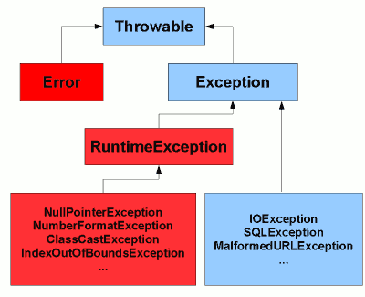
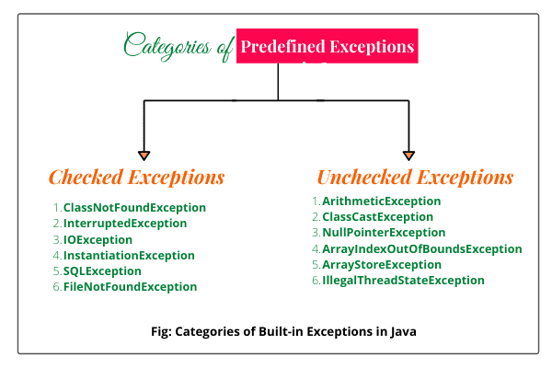
Java checked exceptions are those exceptions, as the name suggests, which a method must handle in its body or throw to the caller method so the caller method can handle it. Checked exceptions are checked by the Java compiler so they are called compile time exceptions.
Unchecked exceptions are not checked by the compiler. These are called runtime exceptions. In Java, a member method is not forced by the compiler to declare the unchecked exceptions into the method declaration. Generally, such methods almost always do not declare them. Unchecked Exceptions are subclasses of RuntimeException class.

Slide 43
Exception
……..
RunTime Exception
IOException
FileNotFoundException
ArithmeticException
ArrayIndexOutOfBoundsException
EOFException
NullPointerException
NumberFormatException

Slide 44
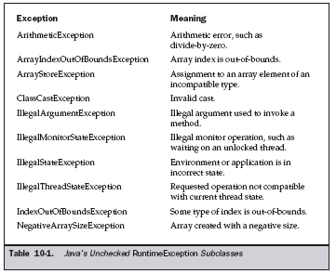
Java’s Built-in Exceptions

Slide 45
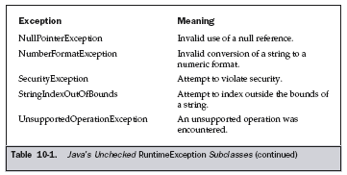

Slide 46
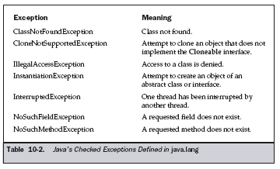

Slide 47
Checked vs Unchecked Exceptions
Checked Exception:
Exception that are checked by compiler whether programmer is handling or not such type of exceptions are called checked exception.
If some code within a method throws a checked exception, then the method must either handle the exception or it must specify the exception using throws keyword.
In the case of checked exception compiler will check whether we are handling exception or not. If the programmer is not handling, then we will get compile time error.

Slide 48
Checked vs Unchecked Exceptions
Checked Exception:
Consider the program to read and prints first three lines of it.
The program doesn’t compile, because FileReader() throws a checked exception FileNotFoundException.
It also uses readLine() and close() methods, and these methods also throw checked exception IOException

Slide 49
import java.io.*;
class prg
{
public static void main(String[] args)
{
FileReader file = new FileReader("C:\\test\\a.txt");
BufferedReader fileInput = new BufferedReader(file);
// Print first 3 lines.
for (int counter = 0; counter < 3; counter++)
System.out.println(fileInput.readLine());
fileInput.close();
}
}

Slide 50
To fix the program:
  we either need to specify list of exceptions using throws, or
  need to use try-catch block.

Slide 51
import java.io.*; class prg { public static void main(String[] args) { try { FileReader file = new FileReader("C:\\test\\a.txt"); BufferedReader fileInput = new BufferedReader(file); // Print first 3 lines. for (int counter = 0; counter < 3; counter++) System.out.println(fileInput.readLine()); fileInput.close(); } catch(Exception e) { } } }

Slide 52
import java.io.*; class prg { public static void main(String[] args) throws IOException { FileReader file = new FileReader("C:\\test\\a.txt"); BufferedReader fileInput = new BufferedReader(file); // Print first 3 lines. for (int counter = 0; counter < 3; counter++) System.out.println(fileInput.readLine()); fileInput.close(); } }

Slide 53
Unchecked Exceptions
Exceptions that are not checked at compiled time.
In C++, all exceptions are unchecked.
It is up to the programmers to be civilized, and specify or catch the exceptions.
In Java exceptions under Error and RuntimeException classes are unchecked exceptions, everything else under throwable is checked.

Slide 54
Below program compiles fine, but throws ArithmeticException when run.
Compiler allows it to compile, because ArithmeticException is an unchecked exception.
class program { public static void main(String args[]) { int x = 0; int y = 10; int z = y/x; } }

Slide 55
Unchecked Exceptions
Throwable
Exception
Error
RunTime Exception
IOException
ArithmeticException
FileNotFoundException
ArrayIndexOutOfBoundsException
EOFException
NullPointerException
NumberFormatException

Slide 56
Unchecked Exceptions
Runtime exception and its child class, Error and its child classes are unchecked exception.
Except this remaining are checked exceptions.

Slide 57
Fully Checked vs partially Checked Exceptions
A checked exception is said to be fully checked if and only if all its child classes also checked.
Ex: IOException
A checked exception is said to be partially checked if and only if some of its child classes are unchecked.
Ex : Exception

Slide 58
Exception
Partially checked exception
……..
Fully checked exception
RunTime Exception
IOException
FileNotFoundException
ArithmeticException
ArrayIndexOutOfBoundsException
EOFException
NullPointerException
NumberFormatException

